Slide 1


AM802002 Research and Enquiry
Week 2 (Session 1): How to conduct a literature review

Slide 2
In this lecture:
Revision
Writing a literature review

Slide 3
Revision
Week 1 Session 1
Week 1 Session 2

Slide 4
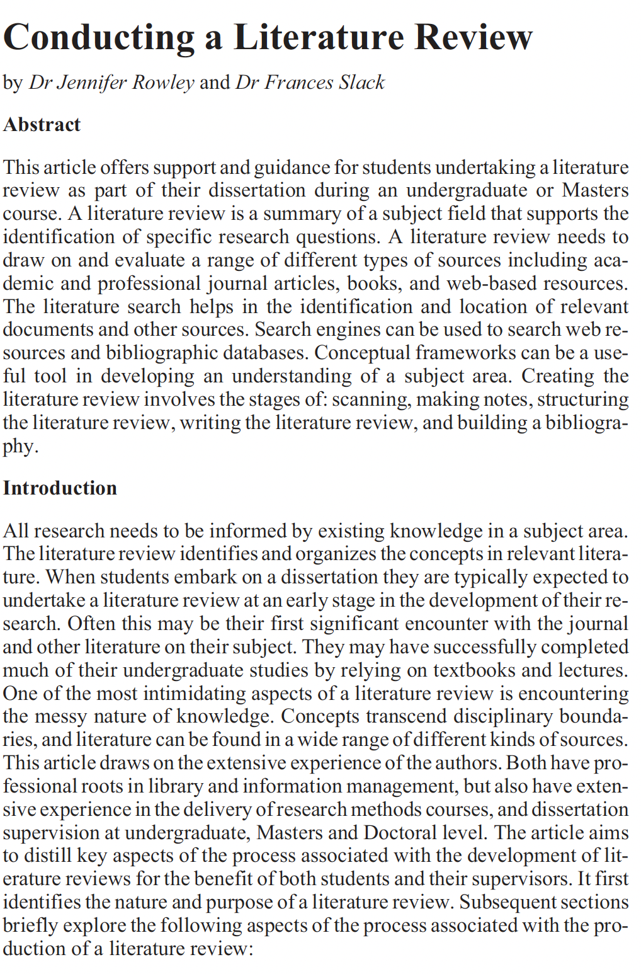
Conducting a literature review
Rowley, J., & Slack, F. (2004). Conducting a literature review. Management research news, 27(6), 31-39.

Slide 5
Activity One (Group)
1. Group discussion around conducting a literature review:
Sitting in groups, listen to the Conducting a Literature Review Podcast
Take some notes as an individual during the podcast
At the end of the podcast, have a group discussion about how to conduct a literature review
Select a team member to present a summary of your discussion to the class

Slide 6
Writing a literature review
Aim:
In this topic, you will learn how to write an academic literature review
Objectives:
Examine how to write academic articles
Examine how to write a literature review
Start writing your literature review for Assignment One.

Slide 7
What is a Literature Review?
Literature reviews are used to explore past research findings to direct and improve future research.
It can also provide a list of important variables, or the things you are measuring or collecting data on, to guide your study
It can also help situate a study within a theoretical perspective
A literature review is not an essay
When writing the literature review, avoid describing a study one-by-one. It is about critically analysing the knowledge of the topic/issue/subject (to compare and contrast)

Slide 8
Why write a literature review?
Determine what has already been written on a topic
Provided an overview of key concepts
Identify major relationships or patterns
Identify strengths and weaknesses
Identify any gaps in the research
Identify any conflicting evidence
Provide a solid background to a research paper’s investigation

Slide 9
Journal articles
Articles in scholarly and research journals should form the core of the literature review.
Most such articles will be written by researchers.
They will include a literature review, a discussion of the research methodology, an analysis of results, and focused statements of conclusions and recommendations.
These articles are designed to record and distil systematically researched knowledge in the area, and have typically been peer-reviewed prior to acceptance for publication.

Slide 10
A good book
relevant to the research topic;
written by an authoritative author; the biographical details given in the book will summarize the authors experience in the field;
up-to-date, as signalled by the publication date;
published by a reputable publisher in the discipline;
one that includes extensive reference to other associated literature; and is
clearly structured and well presented, and easy to read.

Slide 11
Web sources
Who is the intended audience?
What is the frequency of update?
Which organization is the publisher or website originator?
What is the web resource developer’s claim to expertise and authority?
Are there links or references to other relevant web, electronic, or print sources?
What do reviews or evaluations of the site say?
Is a licence or payment necessary for access to the resources?

Slide 12
Organising your thoughts
Chronological
Perspectives of the Author(s)
Method/Methodology used
Topical/Thematic

Slide 13
Organising your thoughts
Concept mapping is a useful way of identifying key concepts in a collection of documents or a research area. Such a map can be used to:
Identify additional search terms during the literature search
Clarify thinking about the structure of the literature review in preparation for writing the review
Understand theory, concepts and the relationships between them.

Slide 14
Drawing Together the Literature Review
There are five steps in the creation of a literature review:
Scanning documents (remember the reading strategy and video)
Making notes
Structuring the literature review
Writing the literature review
Building the bibliography (i.e., your reference list)

Slide 15
Drawing Together the Literature Review
Descriptive
What Happened
What did the author(s) discuss
An account of the topic
Interpretive (Critical)
Ask and answer questions
Analyse, explan and interpret
Synthesis information to develop your point of view

Slide 16
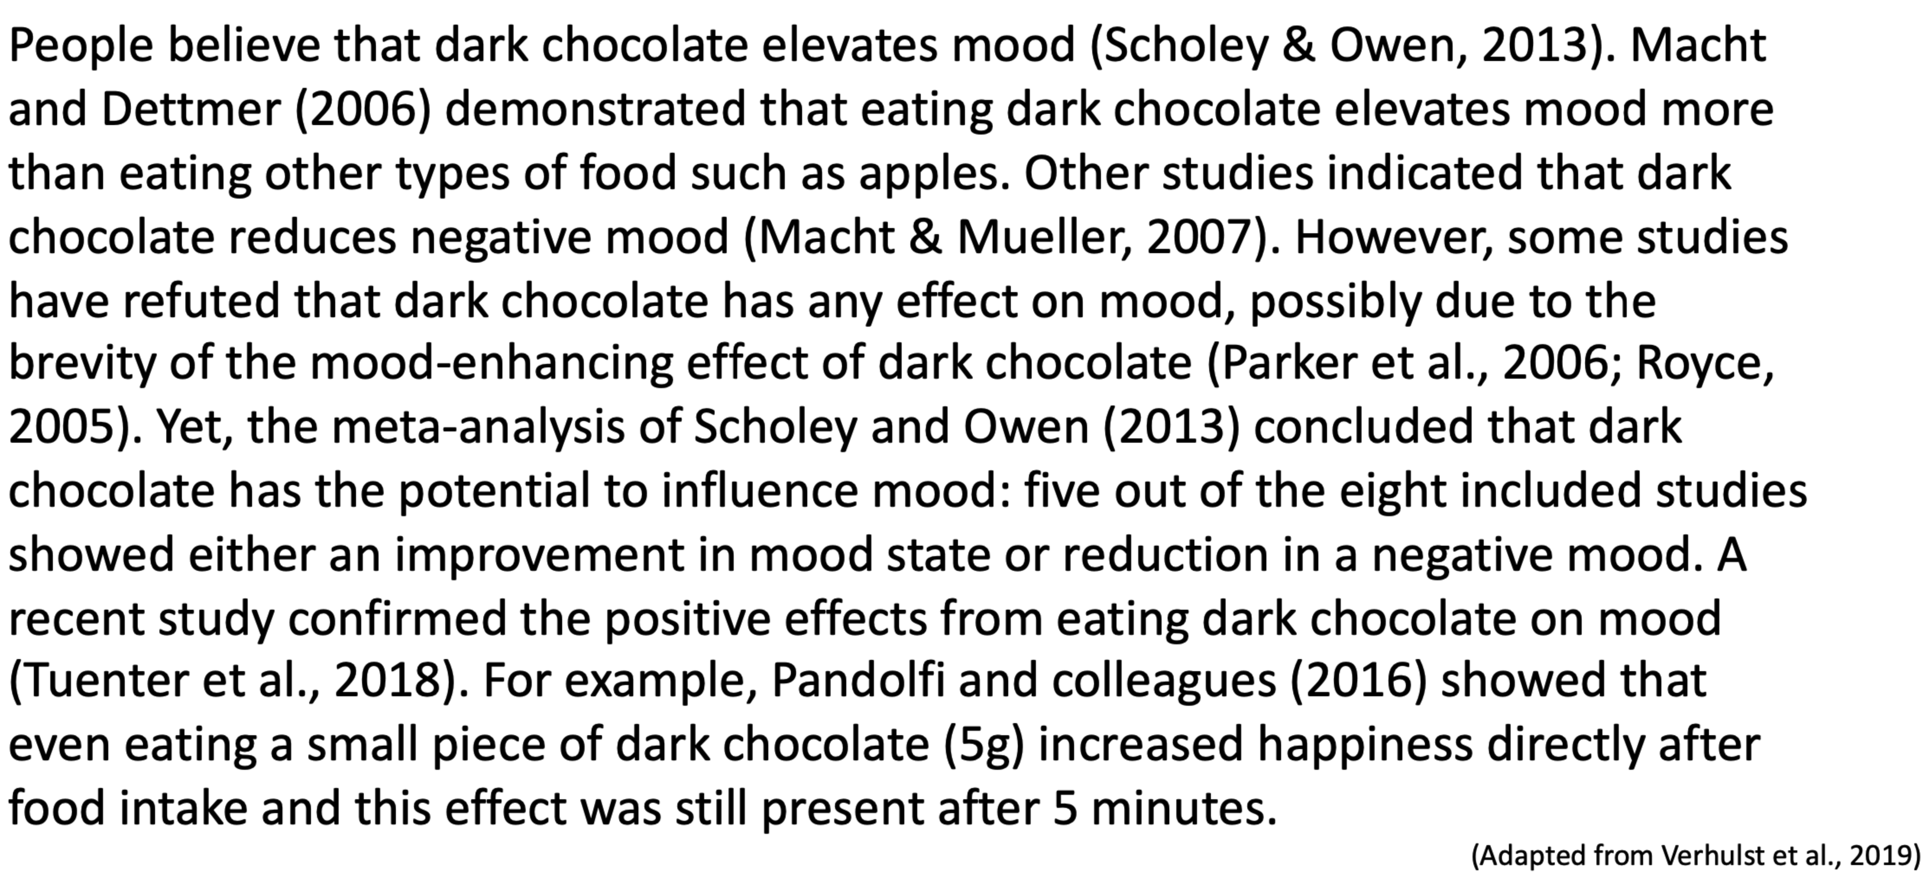
Sample paragraph of a literature review

Slide 17
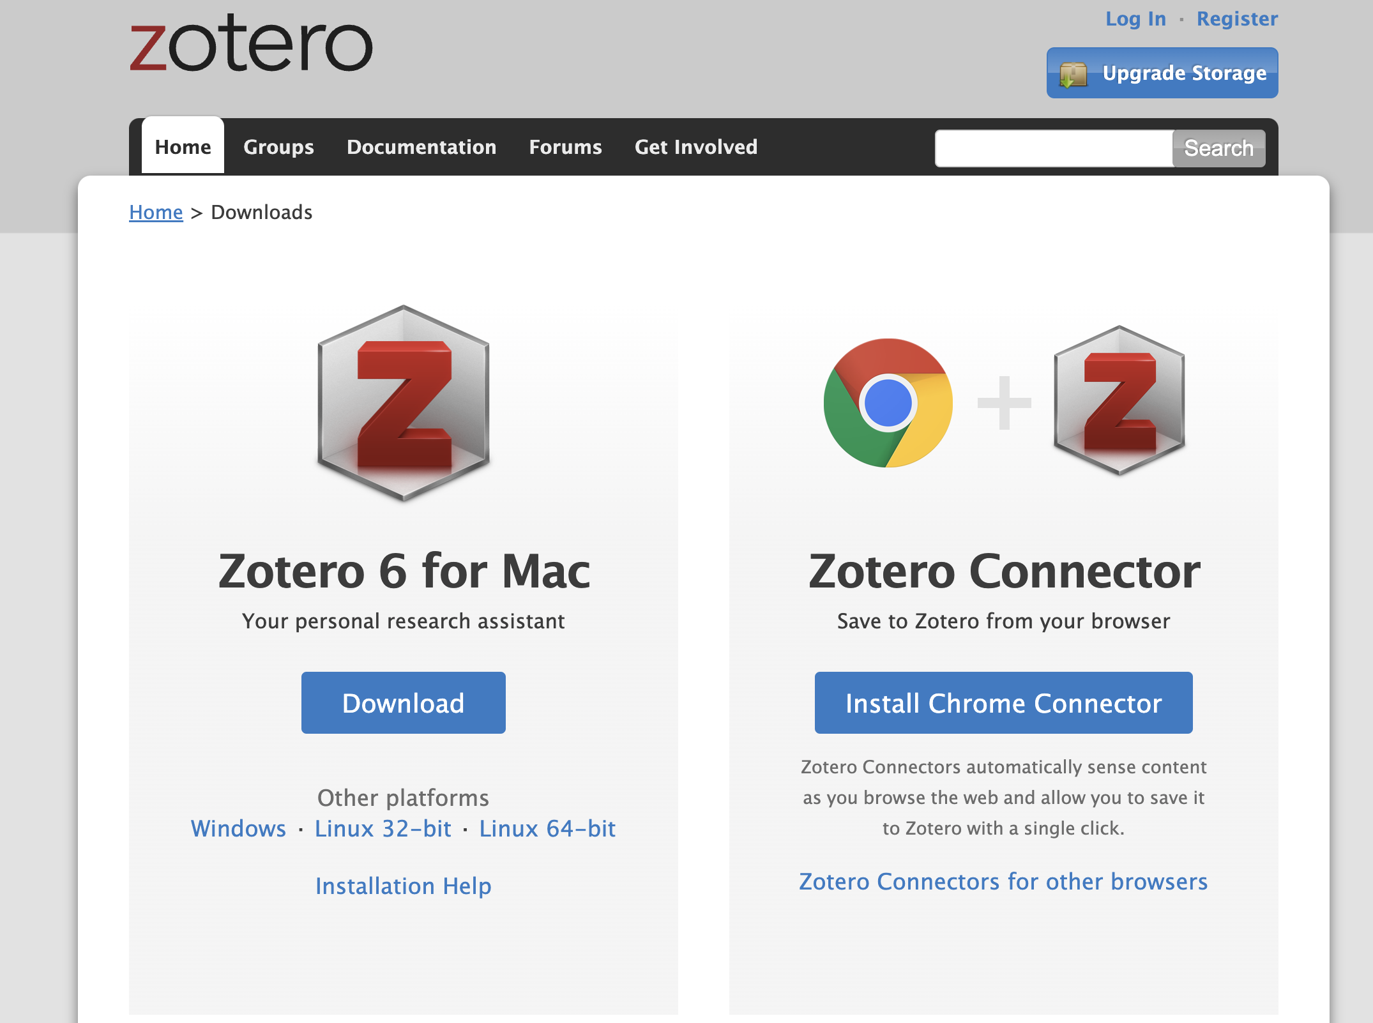
Downloading Zotero
Zotero website: https://www.zotero.org/
How to use Zotero: https://www.youtube.com/watch?v=JG7Uq_JFDzE&t=42s

Slide 18
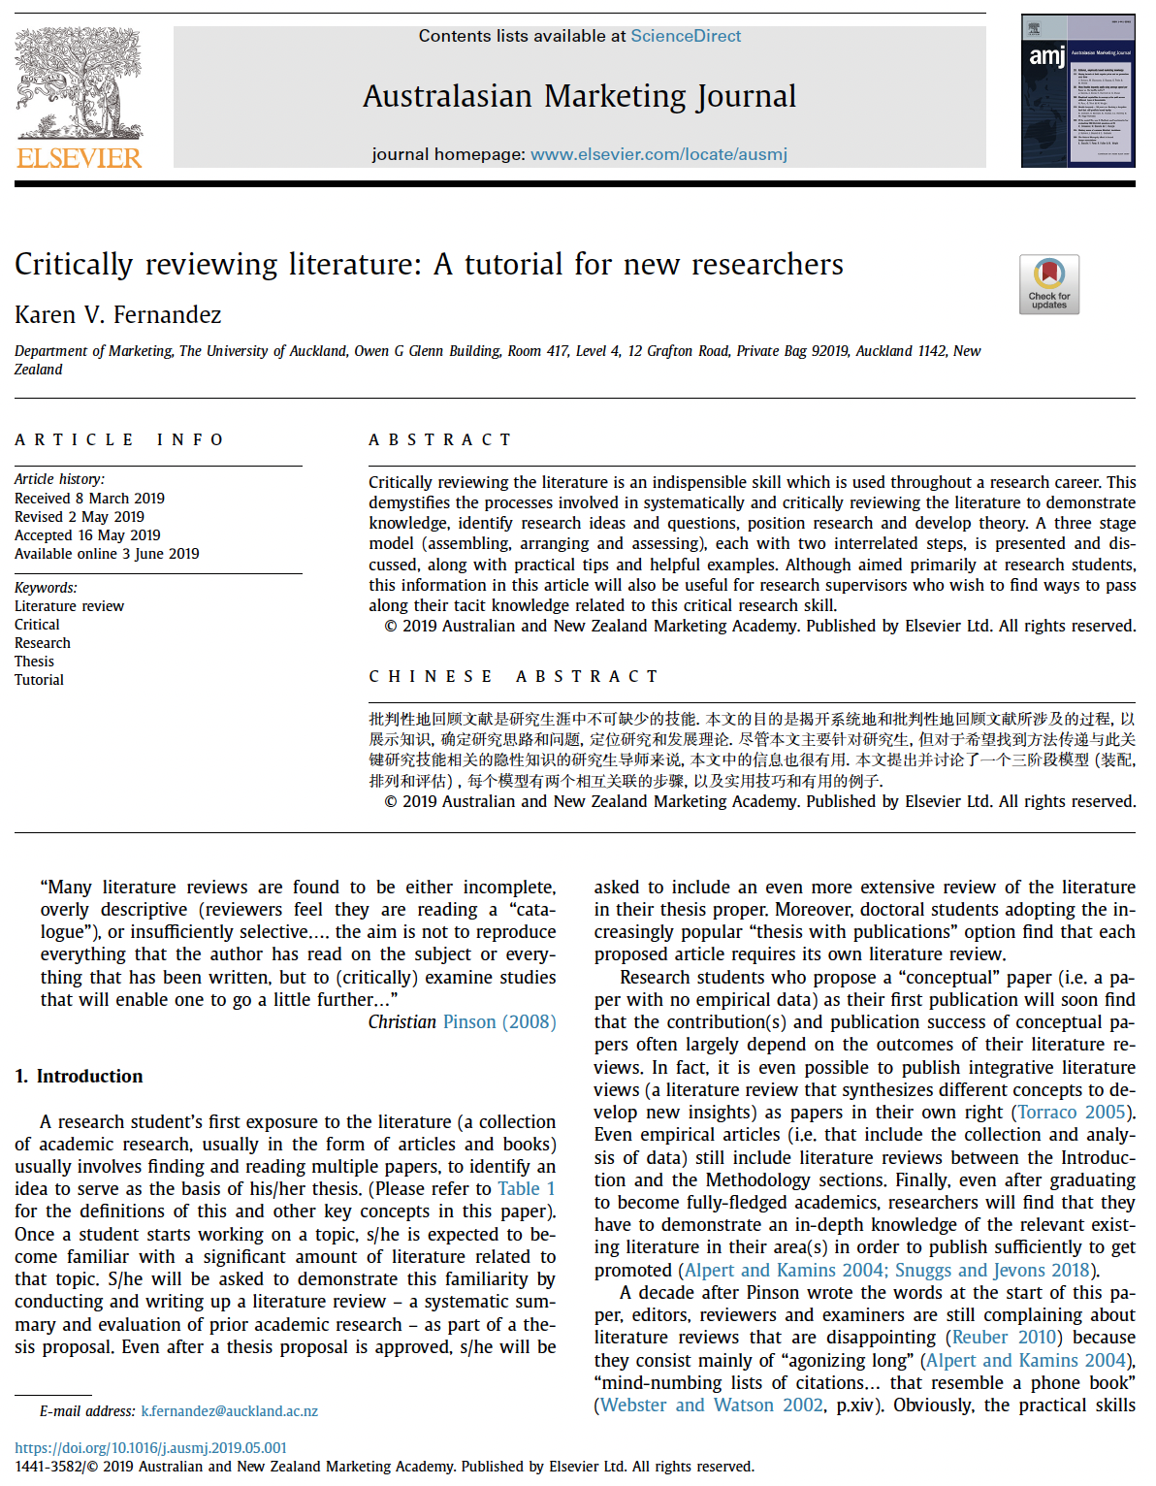
Critically reviewing literature
Fernandez, K. V. (2019). Critically reviewing literature: A tutorial for new researchers. Australasian Marketing Journal, 27(3), 187-196.

Slide 19
Activity Two (Group)
Download and work with the Zotero Collection Folder from Week 2 Module in Teams
Organise into three evenly distributed reading groups
The lecturer will assign one of three collections provided in the folder to each team.
Working as a team, organise the collection of articles into groups
Working as a team, construct a research question that builds on gaps highlighted by the groups or solves a problem demonstrated by these groups.
Present back to the class how you organised these articles into groups and how you either identified a gap in these groups or constructed a problem that these groups have not resolved

Slide 20
Self-study
1. Write a draft paragraph for Assessment One due 9 am Monday 28 October:
To help you get started, have a look at the exemplars of Assessment One on Moodle.
Use your Literature Worksheet and your research question to write a draft paragraph.
2. Get feedback from the RMS Chatbot on your draft.
Have a conversation with the RMS Chatbot about the structure of your draft paragraph.
Write a ten-sentence summary of the conversation.
Add the summary of the conversation in the Assignment One Section of your Teams Notebook.

